Slide 1

Assignment-1 Data Science and Machine Learning Experiment on missing values
Sai Varun Kollipara – C0828403

Slide 2
Data Science
Data science is the field of applying advanced analytics techniques and scientific principles to extract valuable information from data for business decision-making, strategic planning and other uses.

Slide 3
Data Science Sectors
There are multiple areas where data science is being implemented:
Healthcare
Manufacturing
Agriculture
Social Media
Telecommunications

Slide 4
Missing Values
Missing data, or missing values, occur when you don’t have data stored for certain variables or participants. Data can go missing due to incomplete data entry, equipment malfunctions, lost files, and many other reasons.

Slide 5
Missing Values - Types
1. Missing Completely at Random (MCAR) - The missing values on a given variable (Y) are not associated with other variables in each data set or with the variable (Y) itself. In other words, there is no reason for the missing values.
2. Missing at Random (MAR) - MAR occurs when the missingness is not random, but where missingness can be fully accounted for by variables where there is complete information.
3. Missing Not at Random (MNAR) - Missingness depends on unobserved data or the value of the missing data itself

Slide 6
Missing Values – Handling Methods
There are multiple ways to handle this missing values. Here are some of the techniques:
Deletion
Imputation
KNN Imputation

Slide 7
Problem Statement
This experiment is to understand the meaning of missing values, and how to handle them by using real-time data. Like datasets from Kaggle, UCI repository, etc.
The datasets used in this experiment are
Titanic Dataset
The Kaggle interpreter and python programming language are used.

Slide 8
Steps for Missing Data handling Experiment
In the Python notebook, import the packages required for the data preprocessing
Read the dataset from the Kaggle repository.
Examine the dataset – perform some basic visualizations for understanding. Perform describe function to find mean, median, and other mathematical statistics.
Create a function to gather the missing values, calculate the count and percentage of the missing data.
Detecting the missing values using missingno package.
Perform the missing value handling functions – dropping columns, imputation using sklearn package.
Perform missing value handling using the KNN algorithm.

Slide 9
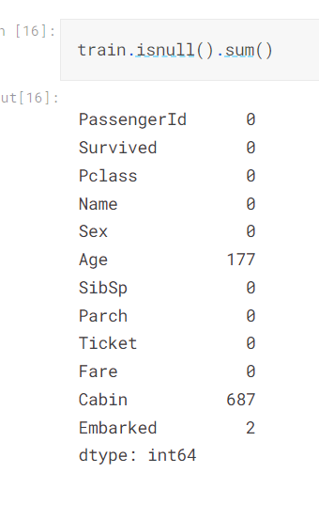
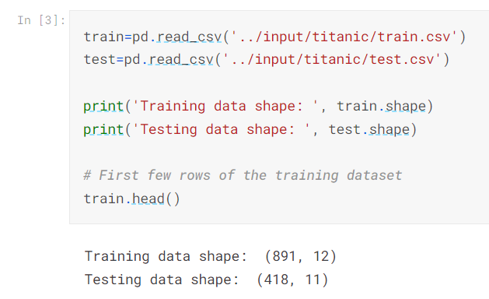
Results on Data Understanding

Slide 10
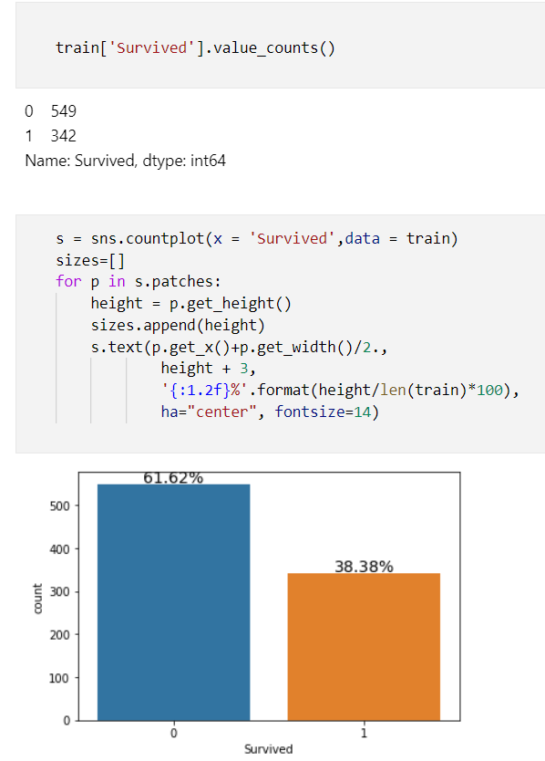
Targeted Columns

Slide 11
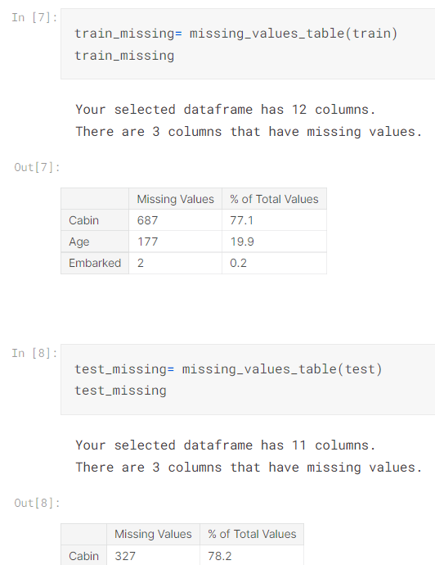
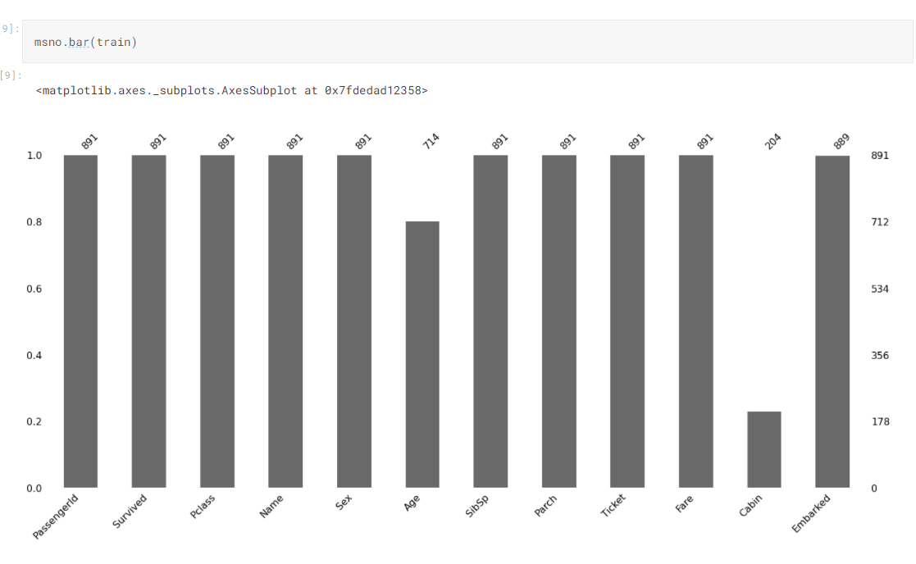
Missing Data Representation

Slide 12
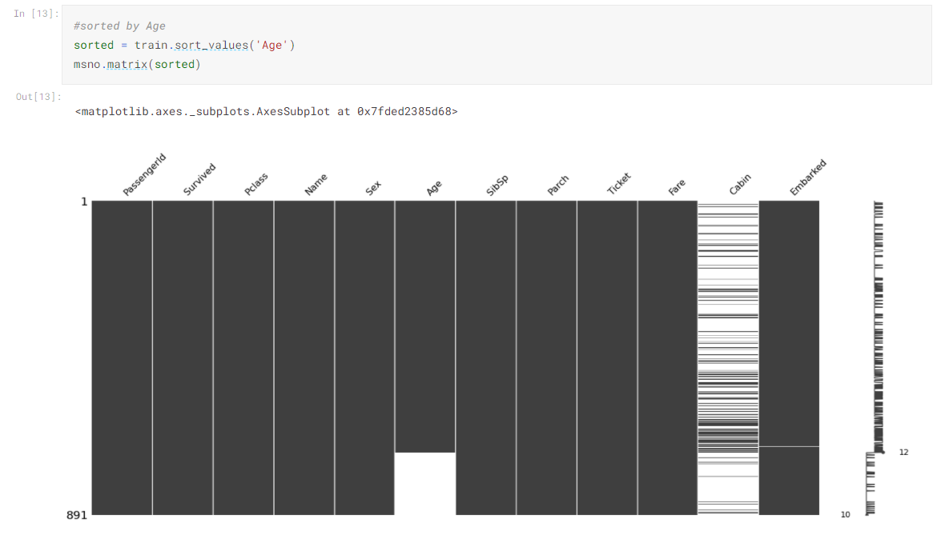
Reasons for Missing Values – in dataset

Slide 13
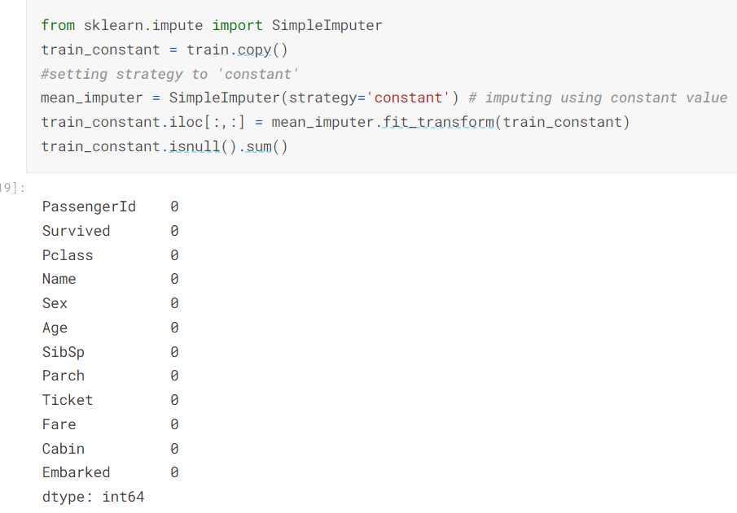
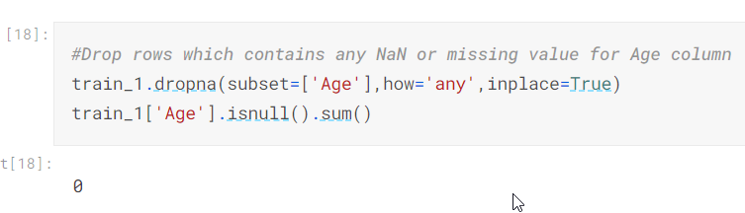
Missing Data Handling using Dropping Row and Imputation

Slide 14
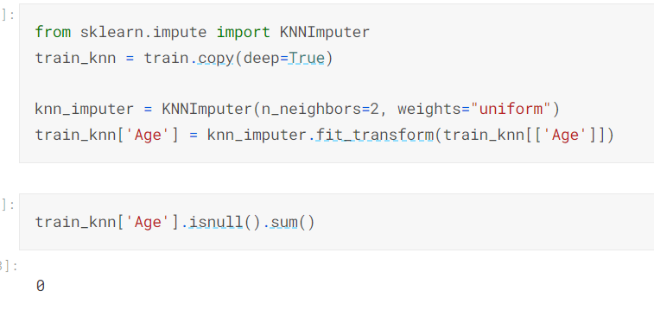
Missing Data Handling using Algorithm

Slide 15
Final Understanding
Here are some of the results for future developments:
The missing value finding is the initial step for developing the accuracy of the data science model.
In this experiment, we can identify some columns and rows with the missing values, and we used imputation and dropping methods to handle the task.
To compare for better results, we can implement the algorithms like XGBoost and LightGBM.
For validation purposes, we can perform a model evaluation with the raw dataset and the dataset, handled with missing values functions.

